Slide 1

Microservices Design
Presenter: Sudhakar Raju

Slide 2
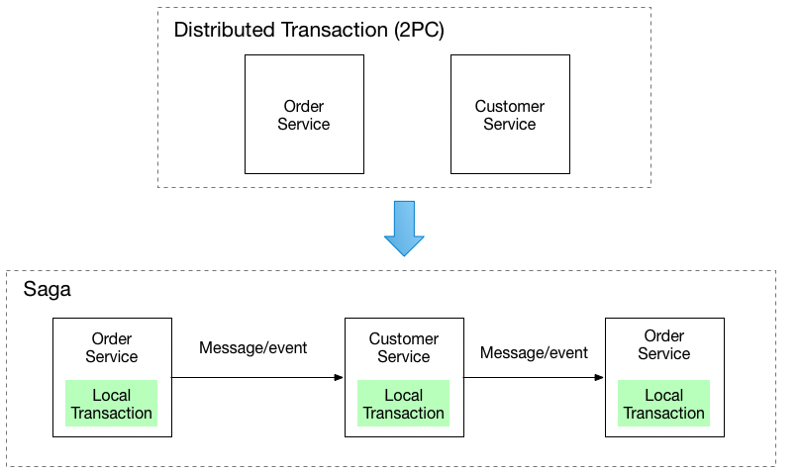
Saga Integration Pattern

Slide 3
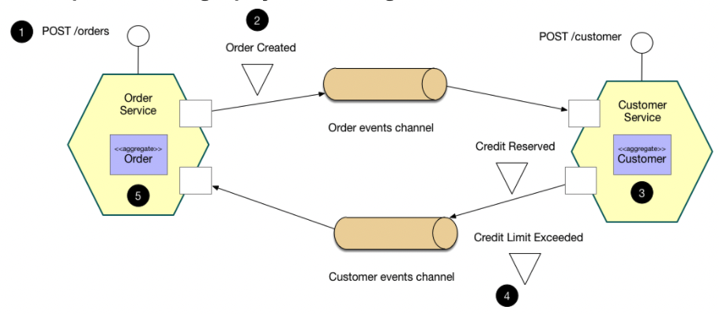
Choreography-based saga

Slide 4
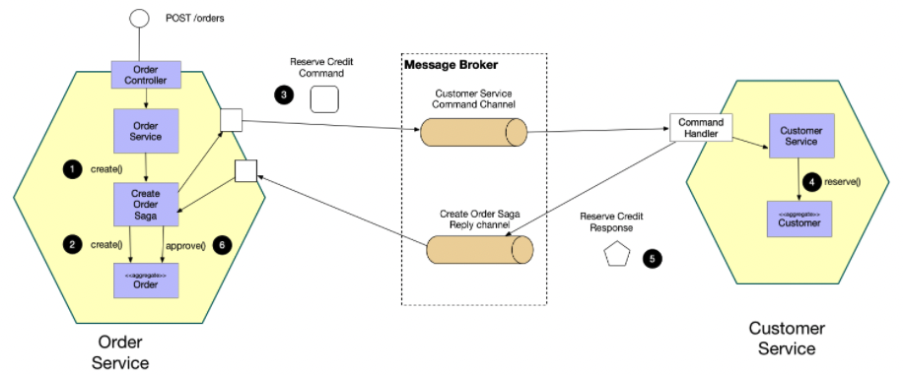
Orchestration-based saga

Slide 5
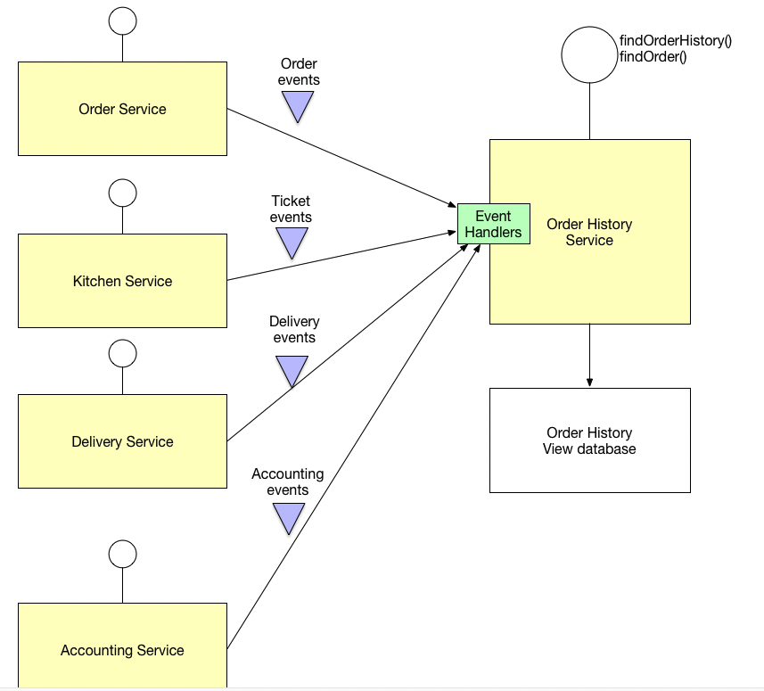
Command Query Responsibility Segregation
it is no longer straightforward to implement queries that join data from multiple services. Also, if you have applied the Event sourcing pattern then the data is no longer easily queried.

Slide 6
CQRS
This pattern has the following benefits:
Supports multiple denormalized views that are scalable and performant
Improved separation of concerns = simpler command and query models
Necessary in an event sourced architecture
This pattern has the following drawbacks:
Increased complexity
Potential code duplication
Replication lag/eventually consistent views

Slide 7
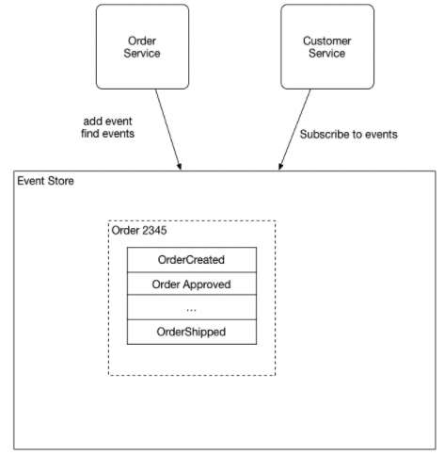
Event Sourcing
Event sourcing persists the state of a business entity such an Order or a Customer as a sequence of state-changing events.

Slide 8
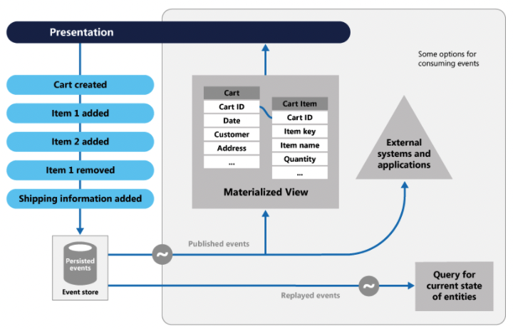
Event Sourcing
https://docs.microsoft.com/en-us/azure/architecture/patterns/event-sourcing

Slide 9
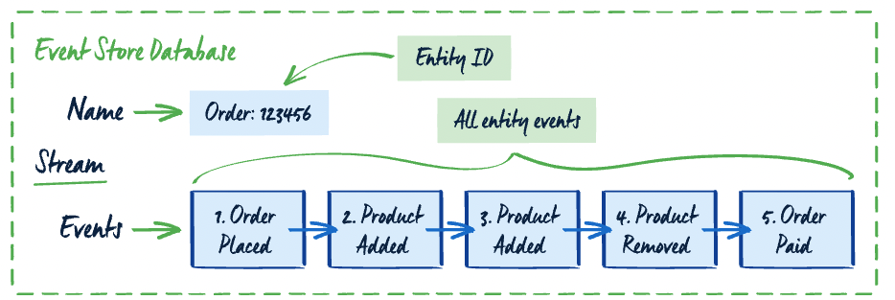
Event Sourcing

Slide 10
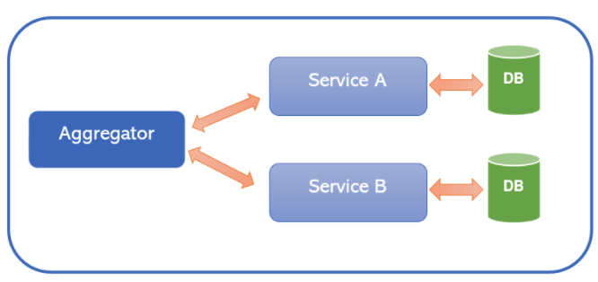
Aggregator Pattern
A service to get Student Information
A service to get Marks & its related Information
A service to get Membership Information
A service to get Achievements Information
Scatter Gather Pattern
Chained Pattern
Branch Pattern
https://medium.com/nerd-for-tech/design-patterns-for-microservices-aggregator-pattern-99c122ac6b73

Slide 11
Aggregator
Real world example
Our web marketplace needs information about products and their current inventory. It makes a call to an aggregator service which in turn calls the product information microservice and product inventory microservice returning the combined information.
In plain words
Aggregator Microservice collects pieces of data from various microservices and returns an aggregate for processing.
Stack Overflow says
Aggregator Microservice invokes multiple services to achieve the functionality required by the application.
https://java-design-patterns.com/patterns/aggregator-microservices/

Slide 12
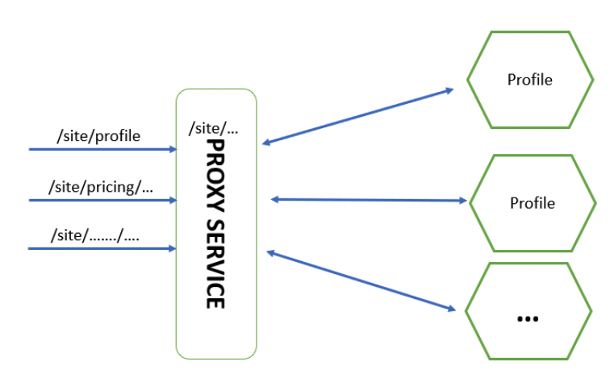
Proxy Pattern
The proxy may be a dumb proxy in which case it just delegates the request to one of the services. Alternatively, it may be a smart proxy where some data transformation is applied before the response is served to the client. A good example of this would be where the presentation layer to different devices can be encapsulated in the smart proxy.
https://www.linkedin.com/pulse/microservices-design-patterns-part-3-patternsproxy-satish-sharma/
https://dzone.com/articles/microservice-design-patterns

Slide 13
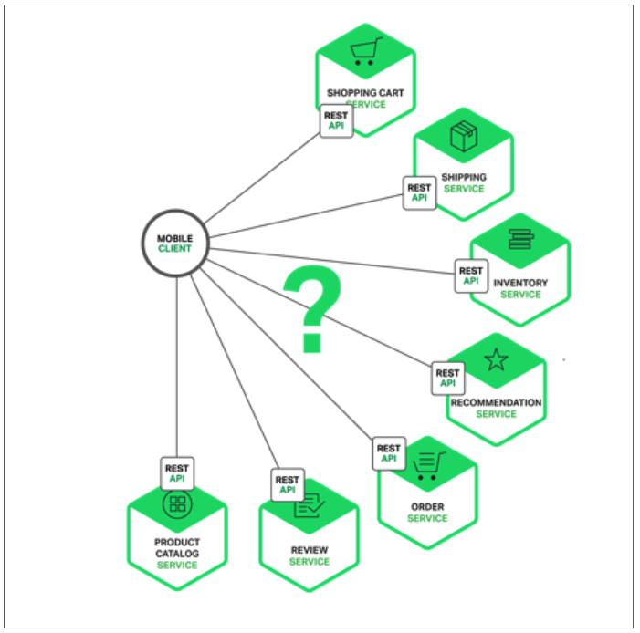
https://www.nginx.com/blog/building-microservices-using-an-api-gateway/#:~:text=The%20API%20Gateway%20is%20responsible,microservices%20and%20aggregating%20the%20results.
API Gateway

Slide 14
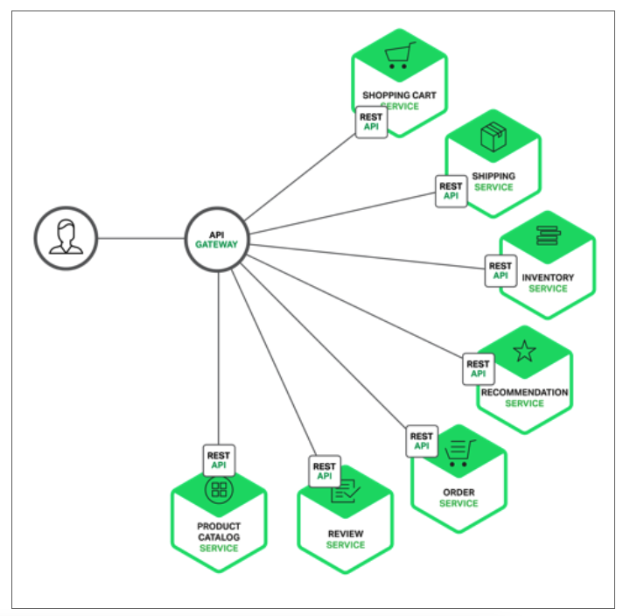
API Gateway
https://www.nginx.com/blog/building-microservices-using-an-api-gateway/#:~:text=The%20API%20Gateway%20is%20responsible,microservices%20and%20aggregating%20the%20results.

Slide 15
API Gateway
A major benefit of using an API Gateway is that it encapsulates the internal structure of the application. Rather than having to invoke specific services, clients simply talk to the gateway. The API Gateway provides each kind of client with a specific API. This reduces the number of round trips between the client and application. It also simplifies the client code.
The API Gateway also has some drawbacks. It is yet another highly available component that must be developed, deployed, and managed. There is also a risk that the API Gateway becomes a development bottleneck. Developers must update the API Gateway in order to expose each microservice’s endpoints. It is important that the process for updating the API Gateway be as lightweight as possible. Otherwise, developers will be forced to wait in line in order to update the gateway. Despite these drawbacks, however, for most real‑world applications it makes sense to use an API Gateway.
https://www.nginx.com/blog/building-microservices-using-an-api-gateway/#:~:text=The%20API%20Gateway%20is%20responsible,microservices%20and%20aggregating%20the%20results.

Slide 16
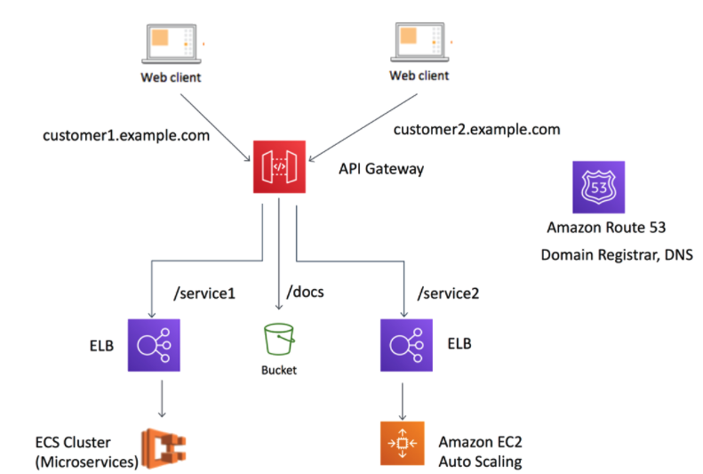
API Gateway
https://aws.amazon.com/blogs/architecture/using-api-gateway-as-a-single-entry-point-for-web-applications-and-api-microservices/

Slide 17
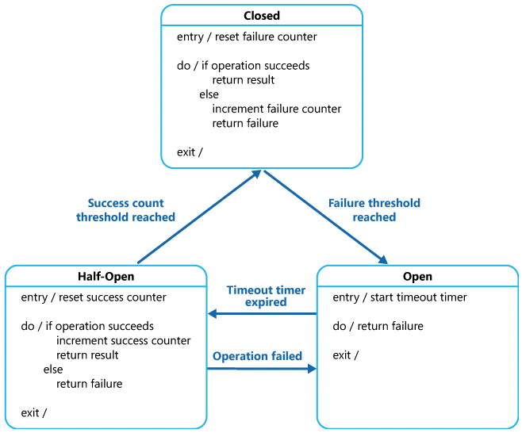
Circuit Breaker

Slide 18
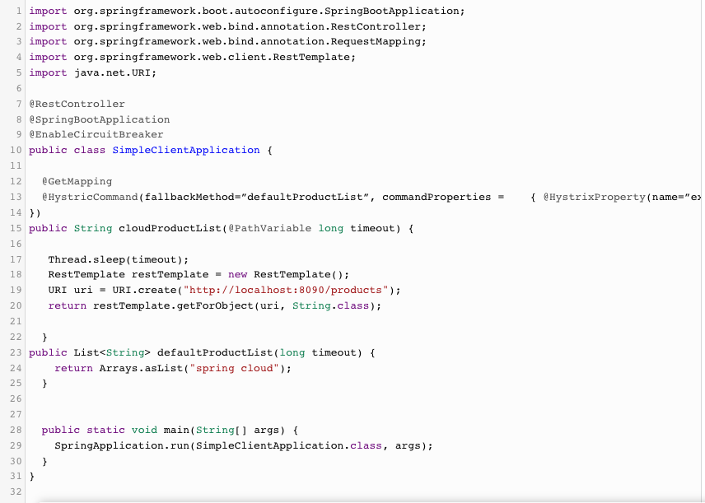
Circuit Breaker with Hystrix
https://dzone.com/articles/circuit-breaker-design-pattern-using-netflix-hystr

Slide 19
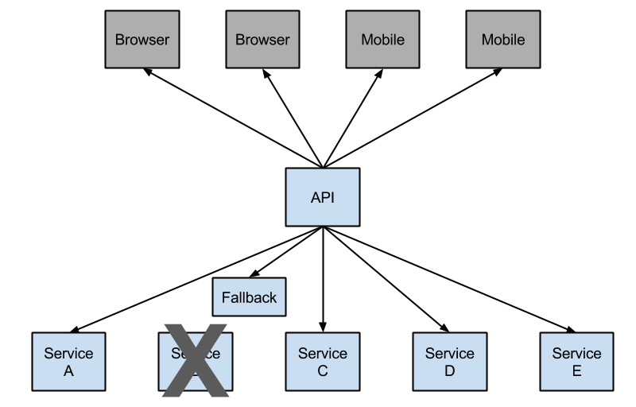
https://cloud.spring.io/spring-cloud-netflix/multi/multi__circuit_breaker_hystrix_clients.html
Hystrix Circuit Breaker
https://www.baeldung.com/spring-cloud-netflix-hystrix

Slide 20
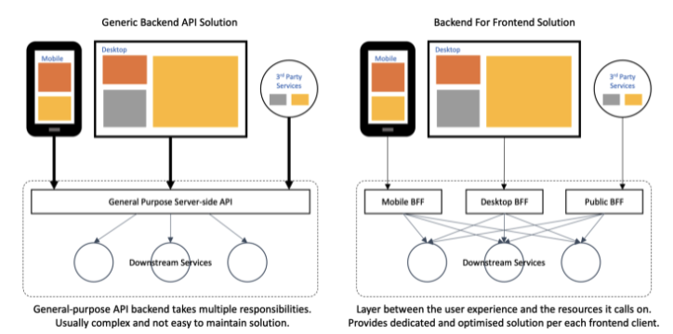
Backend for front End (BFF)
https://medium.com/mobilepeople/backend-for-frontend-pattern-why-you-need-to-know-it-46f94ce420b0

Slide 21
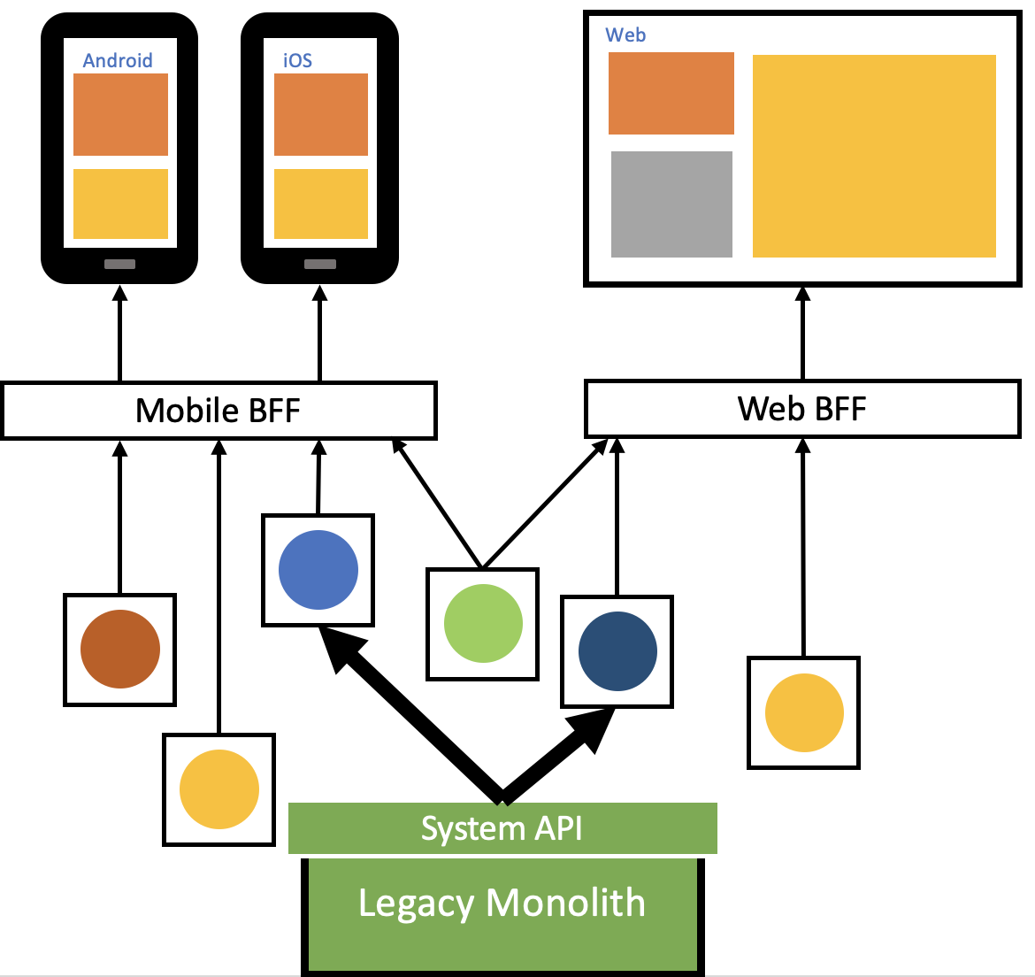
Backend for front End (BFF)
https://medium.com/mobilepeople/backend-for-frontend-pattern-why-you-need-to-know-it-46f94ce420b0

Slide 22
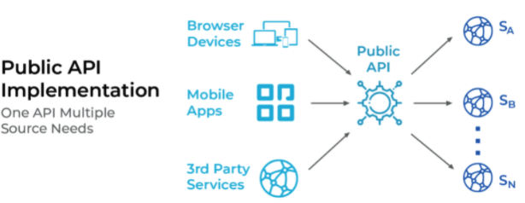
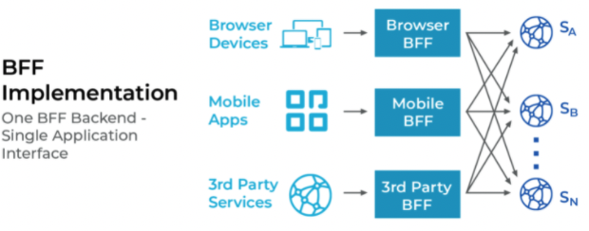
Backend for front End (BFF)
https://www.mobilelive.ca/blog/why-backend-for-frontend-application-architecture/

Slide 23
Backend for front End (BFF)
The Benefits of BFF
BFF is impacting the development community in many positive ways and here are just a few reasons behind its appeal:
Multiple frontend application interfaces can call their respective BFF backends in parallel, and dedicated backend services can respond faster.
Following BFF architecture reduces the time to make modifications and enhancements in backend systems with dedicated teams working on the upgrades.
The BFF layer in the overall system architecture can benefit from hiding sensitive or unnecessary data before transferring it to the frontend application interface, which helps simplify the system.
BFF backend systems can use any protocol like FTP, SOAP, REST or GraphQL to request data from microservices, but still use a single protocol when interacting with the frontend application interface.
Challenges
While the appeal of BFF is evident to even the most novice developers, it’s common to encounter challenges and important to consider them before following BFF:
Fan Out: In BFF, a breakdown of the single service can bring the entire BFF system down. The below diagram shows how a crash in the backend system can cut off your one frontend application interface from the rest of the system.

Slide 24
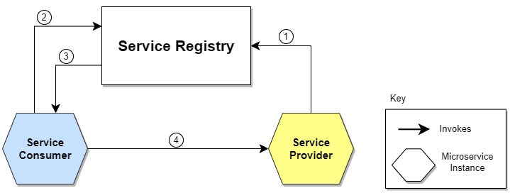
Service Discovery
The location of the Service Provider is sent to the Service Registry (a database containing the locations of all available service instances).
The Service Consumer asks the Service Discovery Server for the location of the Service Provider.
The location of the Service Provider is searched by the Service Registry in its internal database and returned to the Service Consumer.
The Service Consumer can now make direct requests to the Service Provider.

Slide 25
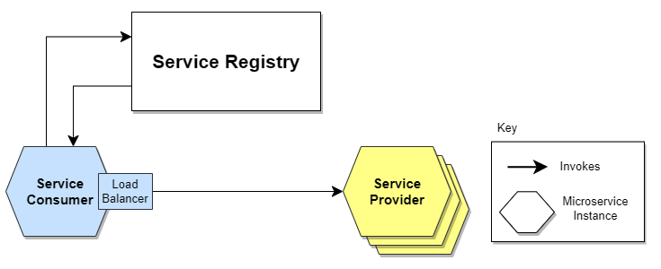
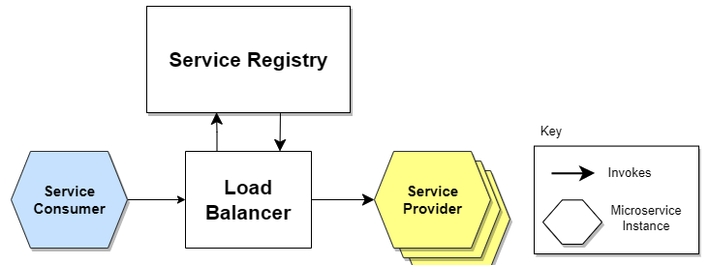
Service Discovery
5.1. Client-Side Service Discovery
Server-Side Service Discovery

Slide 26
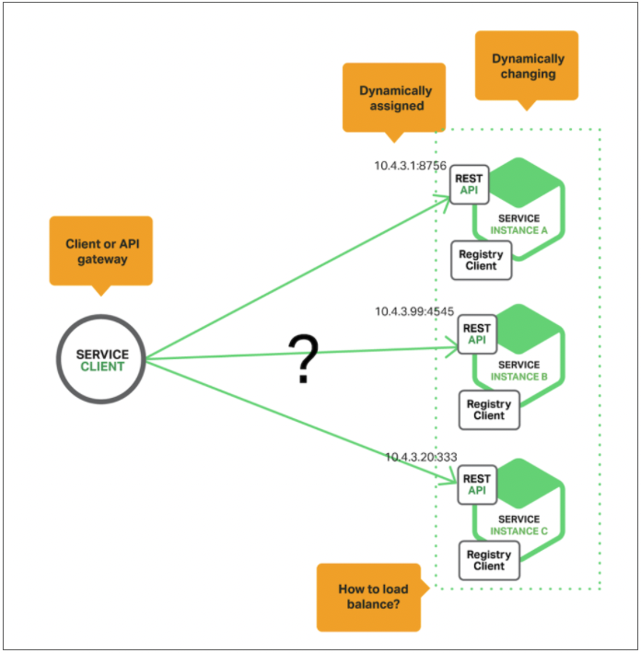
https://www.nginx.com/blog/service-discovery-in-a-microservices-architecture/
Service Discovery
https://www.nginx.com/blog/service-discovery-in-a-microservices-architecture/

Slide 27
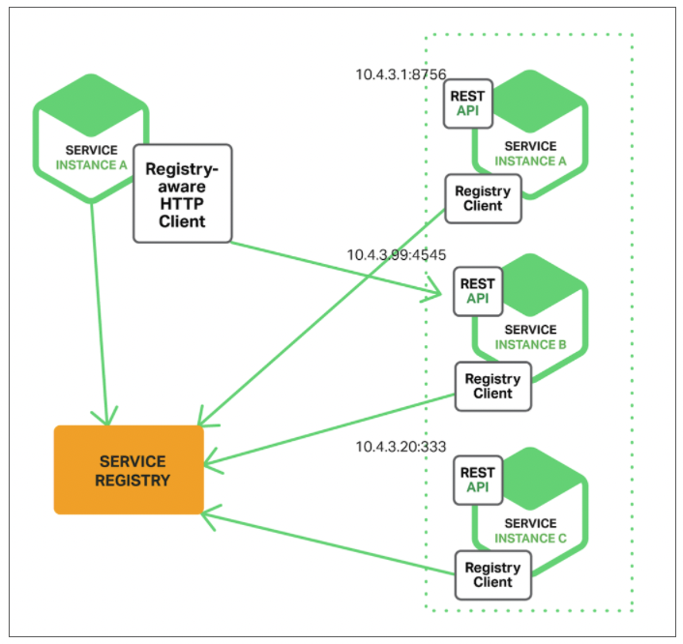
Service Discovery
https://www.nginx.com/blog/service-discovery-in-a-microservices-architecture/

Slide 28
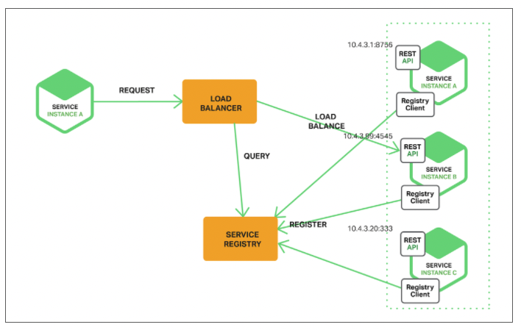
Service Discovery

Slide 29
Microservices Security

Slide 30
Backend for front End (BFF)

Slide 31
Backend for front End (BFF)

Slide 32
Backend for front End (BFF)

